Slide 1
Data Visualization & Interpretation
Febin.A.Vahab

Slide 2
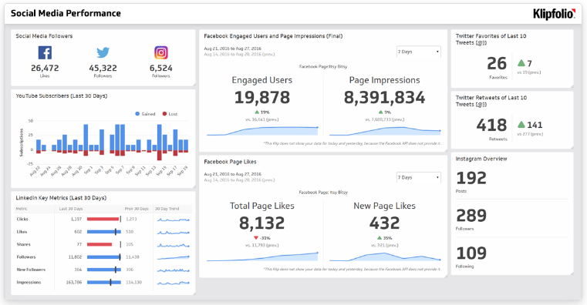
Adapted from: Social Media Performance Dashboard, https://www.klipfolio.com/resources/dashboard-examples/social-media/performance

Slide 3
Session -Agenda
Information Dashboard
Definition
Three 3’s
Characteristics
Effective Design Strategies
Common Dashboard Design Mistakes
Design issues
Display issues
Data issues

Slide 4
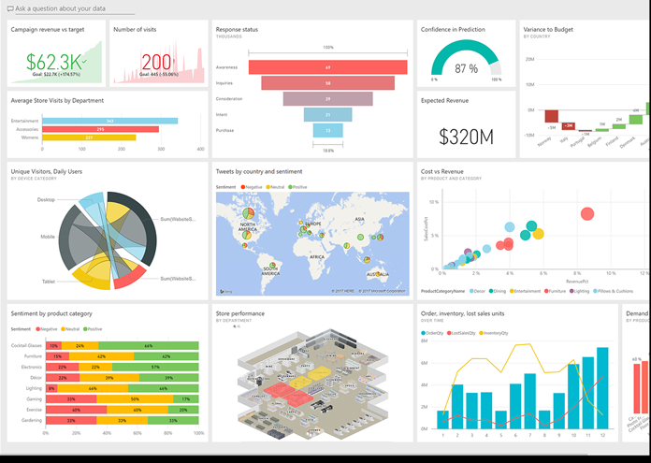
Information Dashboard
A performance dashboard is a layered information delivery system that parcels out information, insights and alerts to users on demand so they can measure, monitor and manage business performance more effectively.
-- Wayne Eckerson

Slide 5
Information Dashboard
Definition
A dashboard is a visual display of the most important information needed to achieve one or more objectives; consolidated and arranged on a single screen so the information can be monitored at a glance.

Slide 6
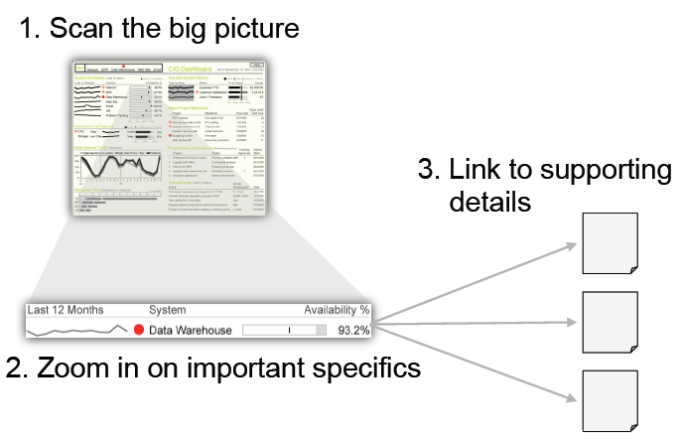
Visual monitoring

Slide 7

Dashboard Characteristics
Visual Displays
Displays information needed to achieve objective
Fits on single computer screen
Displays information in web browser
Monitors information at a glance
Small, clear, intuitive display mechanisms
Customized

Slide 8

Three 3’s
Three 3’s
Three Applications
Three Layers
Three Types

Slide 9
Three 3’s
Three Applications
Management
Foster collaboration and decision making
Support executive meetings
Monitoring
Monitor performance against metrics defined
Operational processes
Analysis
Allows exploration of data across many dimensions
Helps to identify the root cause of exceptional conditions

Slide 10
Three 3’s
Three Applications
 | Monitoring | Analysis | Management
Purpose | Provide information at one sight | Observe exceptions and drill to detail | Decide and refine business strategy
Consists of | Dashboard Scorecard BI Portals Alerts | OLAP Reporting Ad hoc queries | KPIs

Slide 11
Three 3’s
Three informational Layers
Summarised / KPI data
Dimensional data
Detailed data

Slide 12
Three 3’s
Three Layers
Visuals
Dimensions
Details

Slide 13
Three 3’s
Three Types
Strategic Dashboards
Tactical Dashboards
Operational Dashboards

Slide 14
Three 3’s
Strategic Dashboard
Implemented as scorecards
Monitors execution of strategic objectives
Used for review performance by high level executives

Slide 15
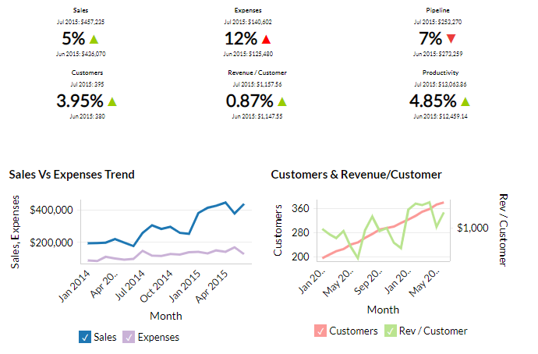
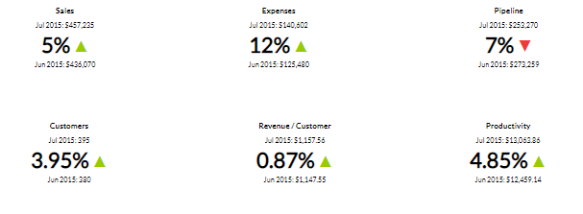
Strategic Dashboard

Slide 16
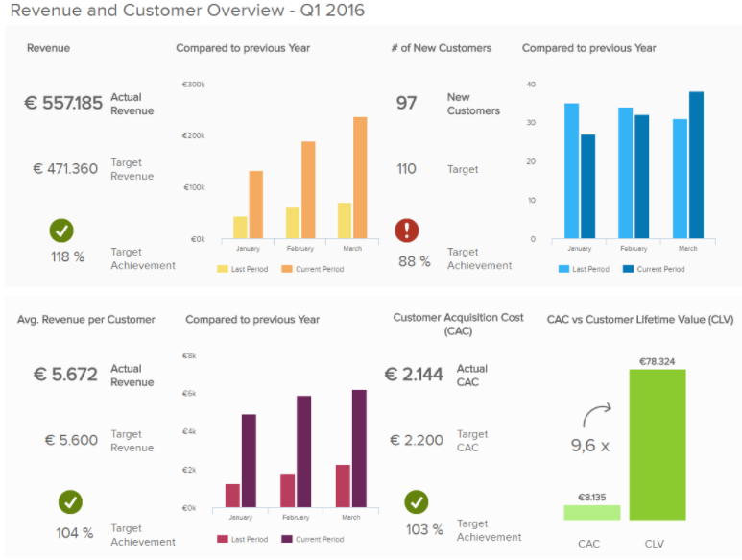
Strategic Dashboard

Slide 17
Three 3’s
Tactical Dashboard
More emphasis on analysis
Uses multidimensional view of data
Monitor and manage departmental processes and projects

Slide 18
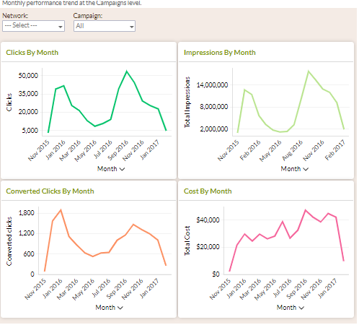

Slide 19
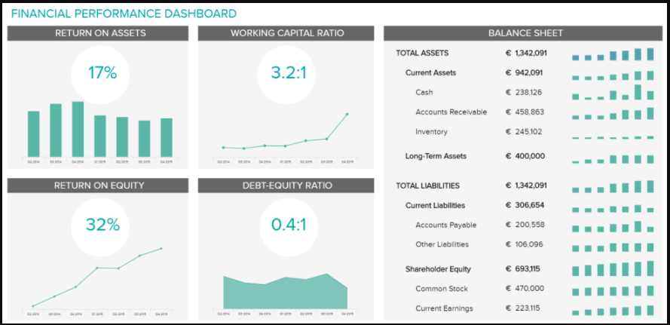

Slide 20
Three 3’s
Operational Dashboard
Used by front line managers to manage processes
Uses detailed data which is refreshed continuously
Monitoring application

Slide 21
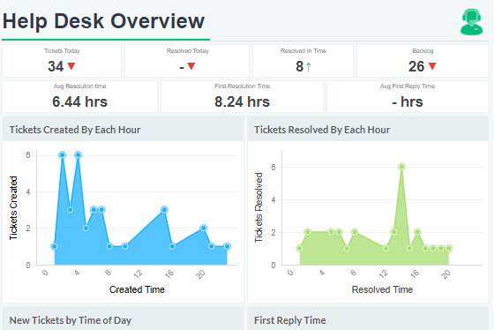

Slide 22
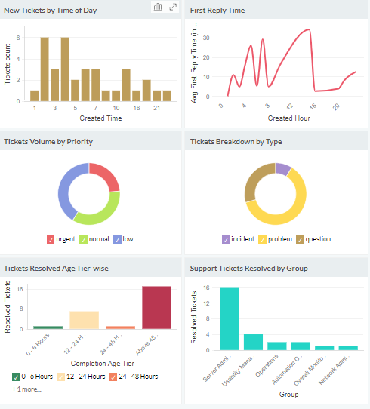

Slide 23
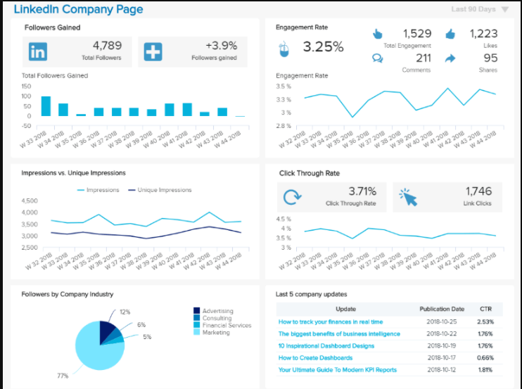
LinkedIn Operational Dashboard

Slide 24
Three 3’s
 | Operational | Tactical | Strategic
Objective | Processes Monitoring | Process Improvement | Strategy refinement
Level | Process | Department | Organization
Users | Front line managers Junior Management | Analyst / Managers Middle management | Executives Senior Management
Focus area/ Time Application | Act immediately/ Routine | Root cause analysis/ Medium term | Future Perspective/ Long term
Data refresh | Daily | Week or higher | Month or higher
Data | Detailed | Dimensional | Summarized

Slide 25
Design Challenge
The fundamental challenge of dashboard design is to display all the required information on a single screen:
clearly and without distraction
in a manner that can be quickly examined and understood

Slide 26
Best Practices for Effective Dashboard Design
Thoughtful Planning
1. Know your audience
2. Consider display size
3. Plan for fast load times
Informed Design
4. Leverage the sweet spot
5. Limit the number of views and colors
6. Add interactivity to encourage exploration
7. Maximize the data-ink (or data-pixel) ratio.
8. Data specific to and customized for the task
9. Eliminate clutter
10. Test your dashboard for usability.

Slide 27
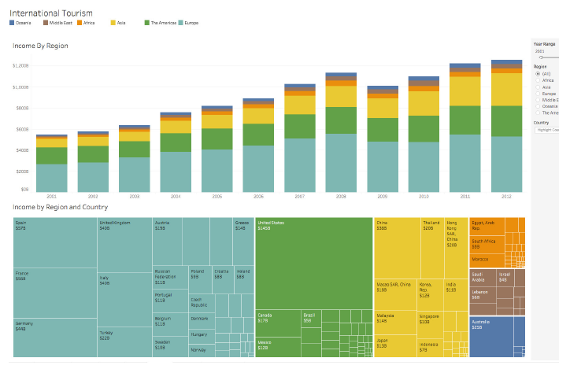
Know your audience

Slide 28
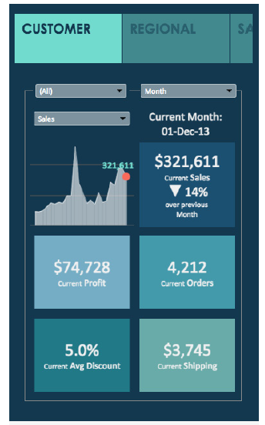
Consider display size

Slide 29
Plan for fast load times
Dashboard won’t have an impact if it takes too long to load
Perform calculations in the database to reduce overhead
Limit the amount of data surfaced in your dashboard, either by creating filters on a data source or creating an extract

Slide 30
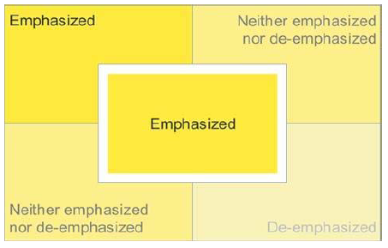
Leverage the sweetspot

Slide 31
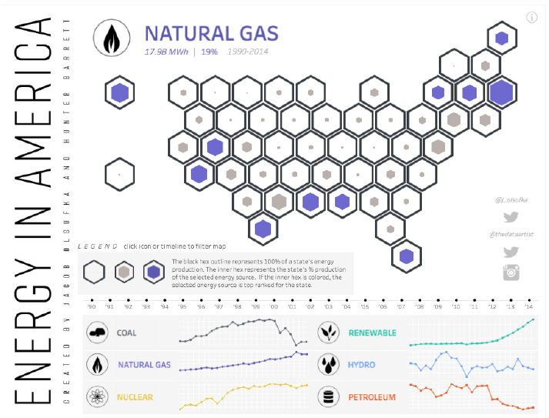
Leverage the sweetspot

Slide 32
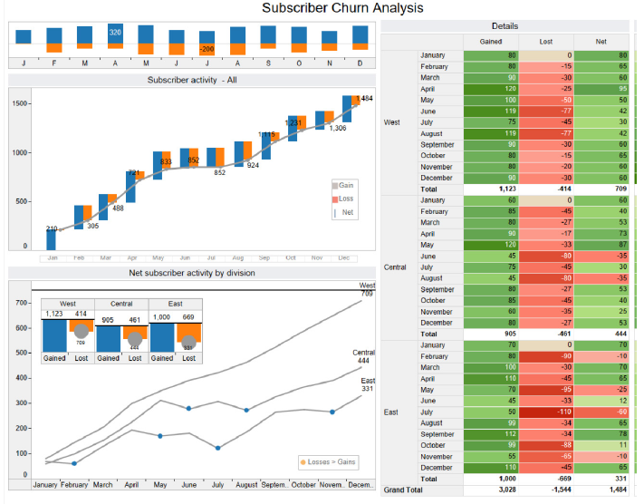
Limit the number of views and colors

Slide 33
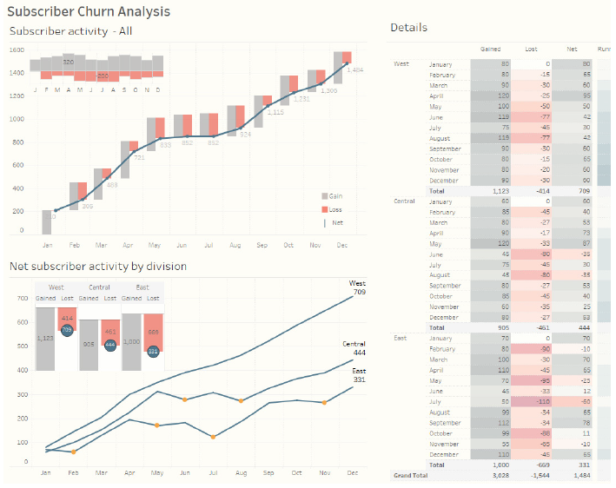
Limit the number of views and colors

Slide 34
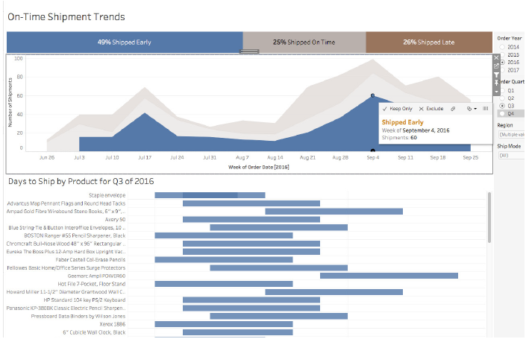
Add interactivity to encourage exploration

Slide 35
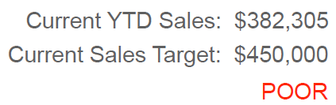
Maximize the data-ink (or data-pixel) ratio.
Data condensed in the form of summaries and exceptions

Slide 36
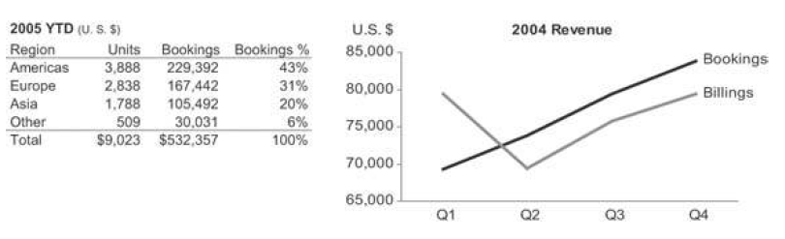
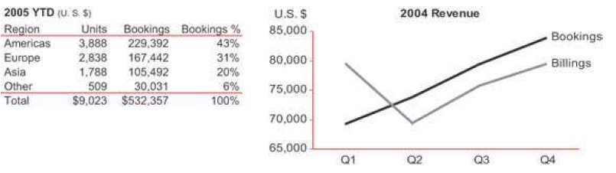
Maximize the data-ink (or data-pixel) ratio.

Slide 37
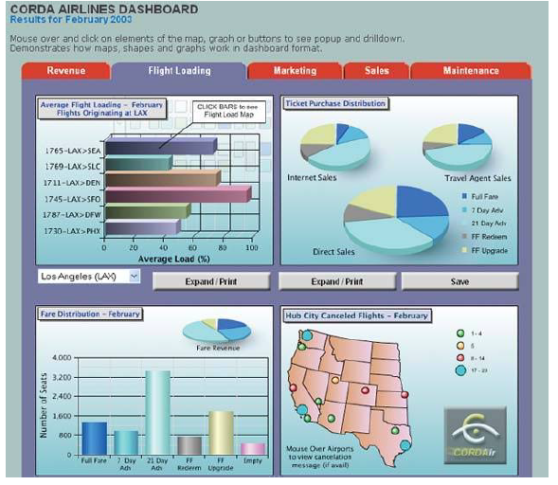
Identify the non data ink

Slide 38
Data specific to and customized for the task
Display data fully and meaningfully.
Concise, clear, and often small display mechanisms
Group data into logical sections.
Not all dashboard widgets are equally effective.
Those that work well exhibit the following characteristics:
Clear display for efficient reading
Clear meaning for efficient understanding
Appropriate medium for the message
Maximum relevant content in the space available

Slide 39
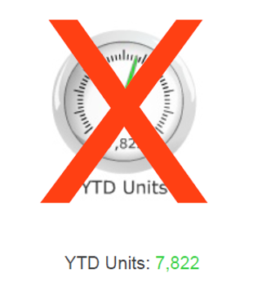
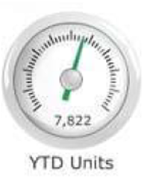
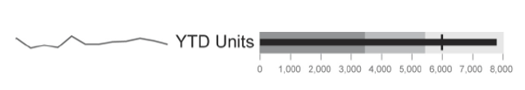
Display data fully and meaningfully

Slide 40
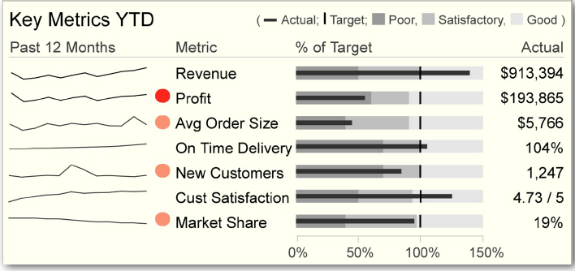
Data specific to and customized for the task

Slide 41
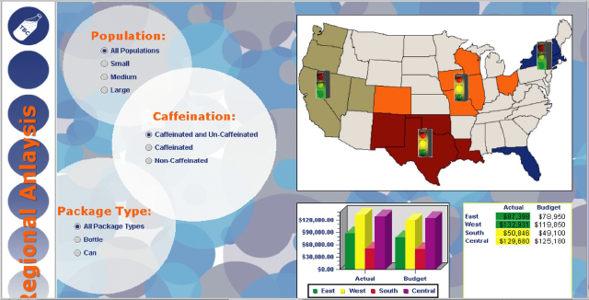
Eliminate clutter and distraction

Slide 42
Test your dashboard for usability
Ask your audience how they’re using the dashboard and if it helps them answer their pressing questions
Have they created their own versions of the dashboard?
Are they digging into certain views and ignoring others?
Use this information to tweak the existing dashboard or develop new ones

Slide 43
Display Medium for dashboards

Slide 44
Select the best medium of display.
Tables
For look up
To display sets of individual measures
To display simple lists
To display simple rankings
For numeric precision
For combining summary and details in the same display
Graphs
To display relationships in the data (e.g., trends, patterns, and exceptions)
Other graphics
To assign qualitative assessments to data
To highlight urgent or important data

Slide 45
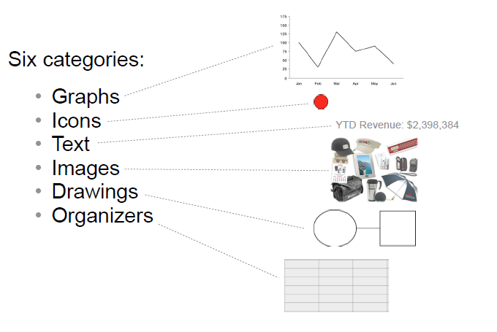
Ideal Selection of Display Mediums

Slide 46
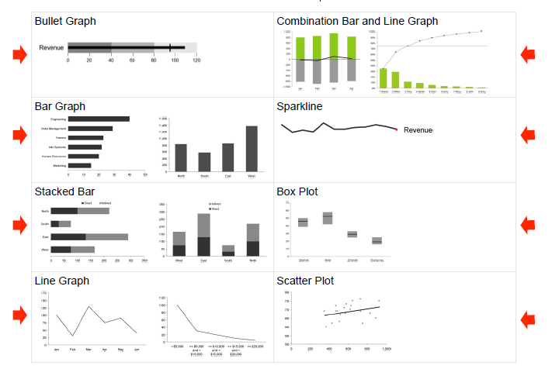
Graphs

Slide 47
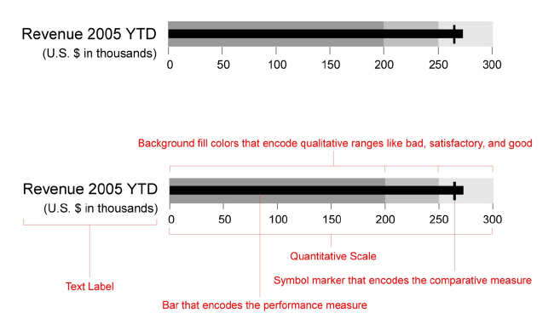
Bullet Graphs

Slide 48
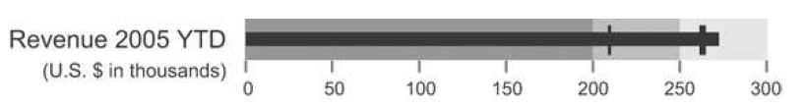
Bullet Graphs
It is sometimes useful to compare a key measure to more than one other measure.
You might want to compare revenue to the revenue target and to the revenue amount.
The bullet graph easily handles multiple comparisons by using a distinct marker for each.
These distinctions can be displayed using variables of color intensity, line width (a.k.a. stroke weight), or even symbol shapes in a pinch.

Slide 49
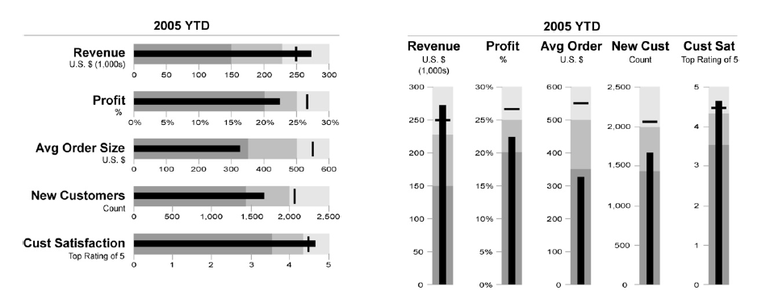
Bullet Graphs-Many can fit into a small space.

Slide 50
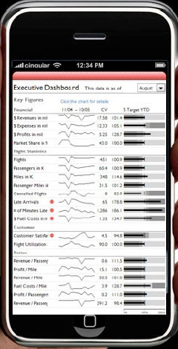
Bullet Graphs-Many can fit into a small space.

Slide 51
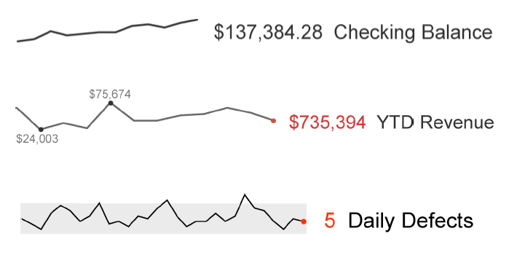
Sparklines

Slide 52
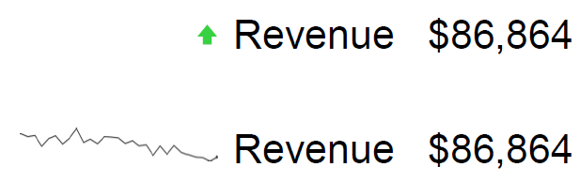
Sparklines

Slide 53
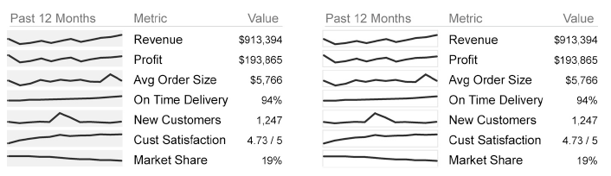
Sparkline Containers

Slide 54
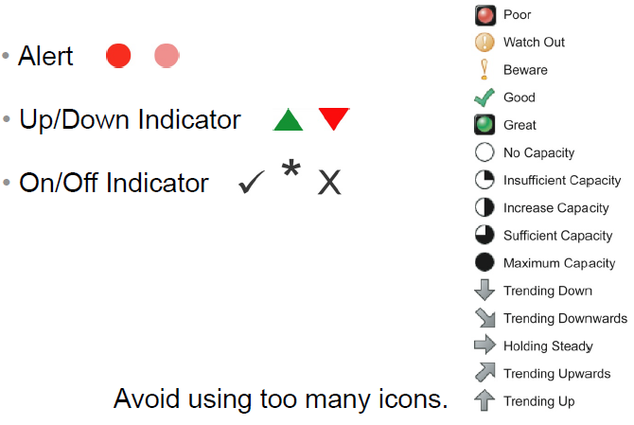
Icons

Slide 55
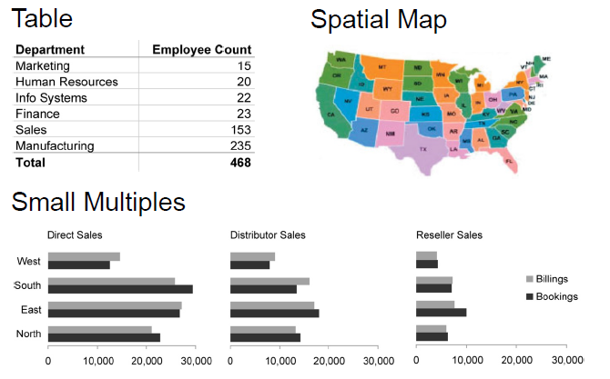
Organizers

Slide 56
Dashboard Design
Challenge
How to fit great amount of information into small amount of space?
--- still keeping the easily usable and understandable display

Slide 57
Dashboard Design Mistakes
Design issues
Exceeding the boundaries of single screen
Meaningless Variety
Cluttering the display with useless decoration
Unattractive visual display

Slide 58
Dashboard Design Mistakes
Display issues
Inappropriate display media
Poorly designed display media
Misusing or overusing colors

Slide 59
Dashboard Design Mistakes
Data issues
Inadequate context for the data
Using excessive detail or precision
Using deficient measure
Incorrect data encoding
Poor data arrangement
Ineffective data highlighting

Slide 60
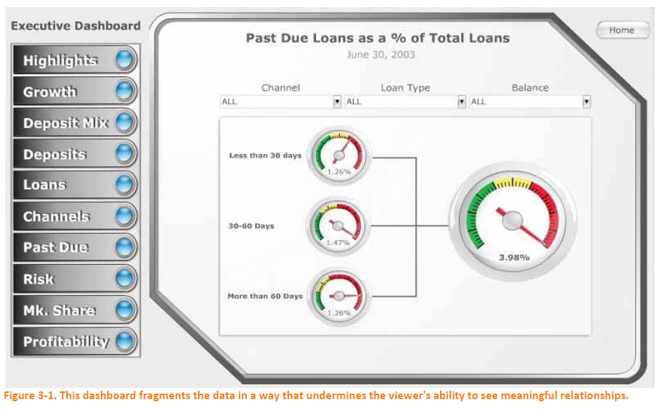
Design issues
Exceeding the boundaries of single screen - segments

Slide 61
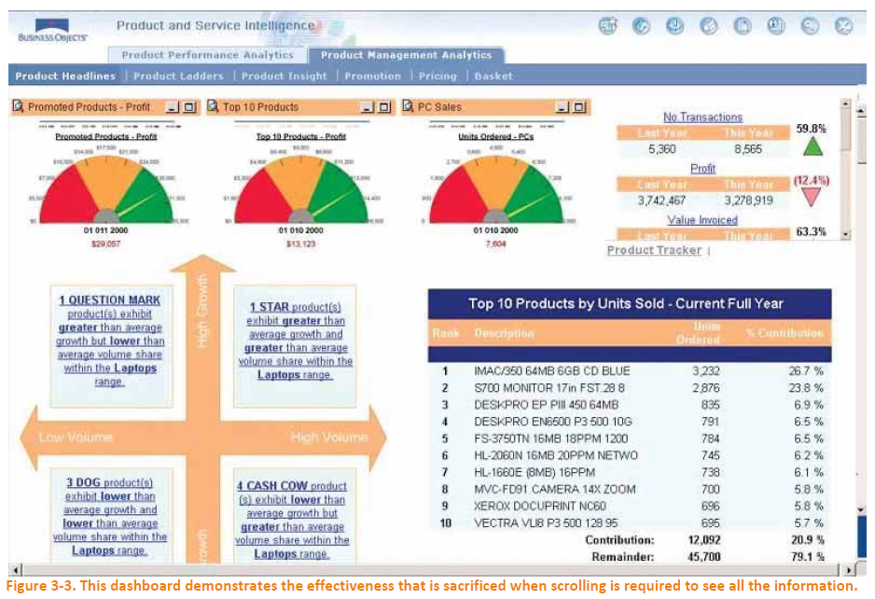
Design issues
Exceeding the boundaries of single screen - scrolling

Slide 62
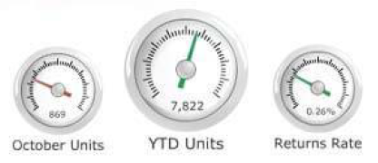
Data issues
Inadequate context for the data
- These dashboard gauges fail to provide adequate context to make the measures meaningful

Slide 63
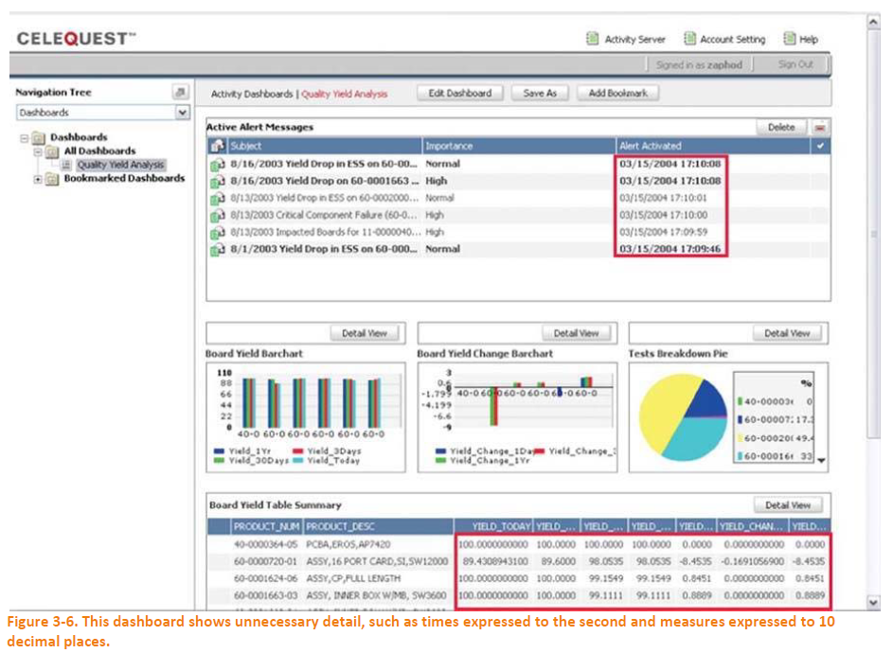
Data issues
Using excessive detail or precision

Slide 64
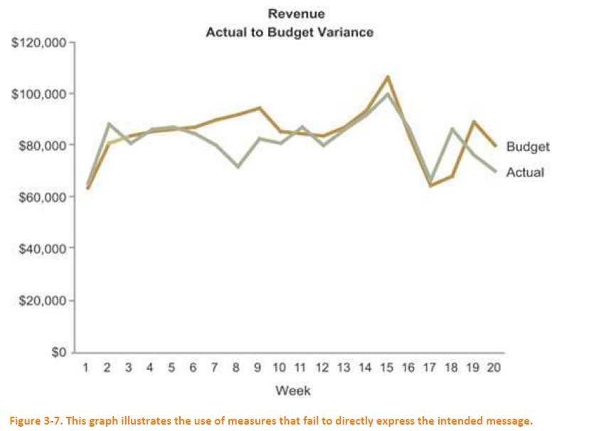
Data issues
Using deficient measure

Slide 65
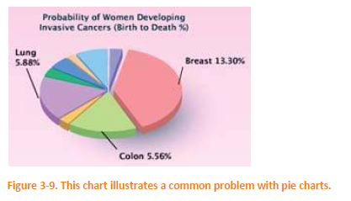
Display issues
Inappropriate display media – Problems with Pie chart

Slide 66
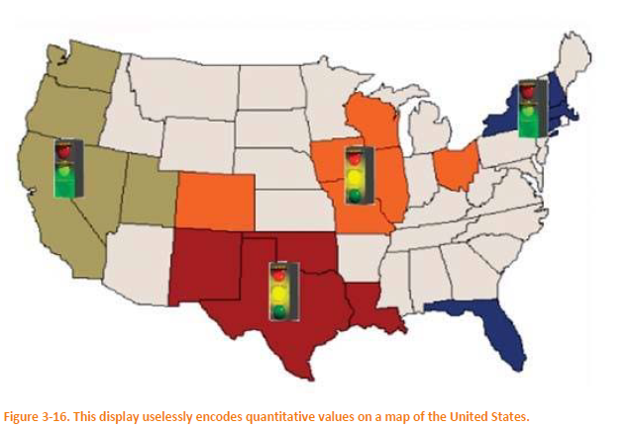
Display issues
Inappropriate display media
- Uselessly encodes quantitative values on a map of the US

Slide 67
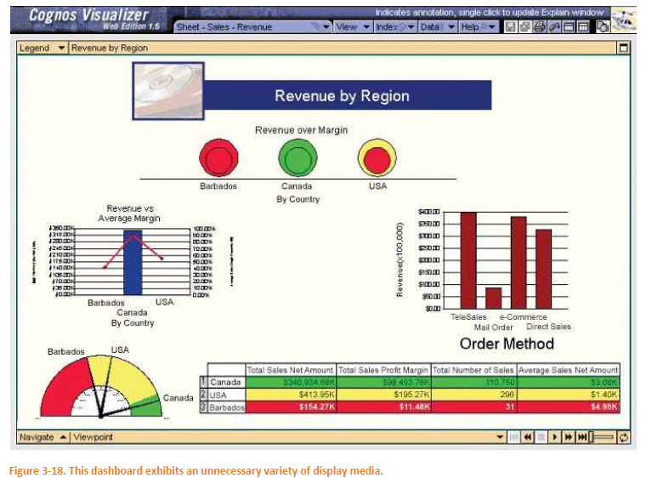
Design issues
Meaningless Variety

Slide 68
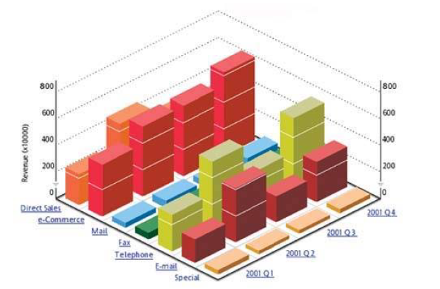
Display issues
Poorly designed display media
- Difficult to read for the 3D design

Slide 69
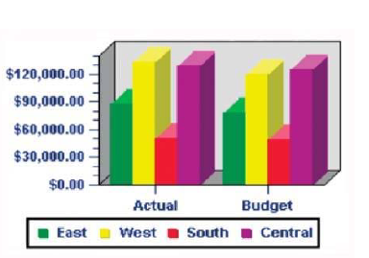
Display issues
Poorly designed display media
- Many examples of poor design features

Slide 70
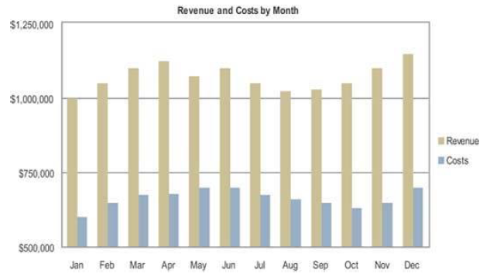
Data issues
Incorrect data encoding

Slide 71
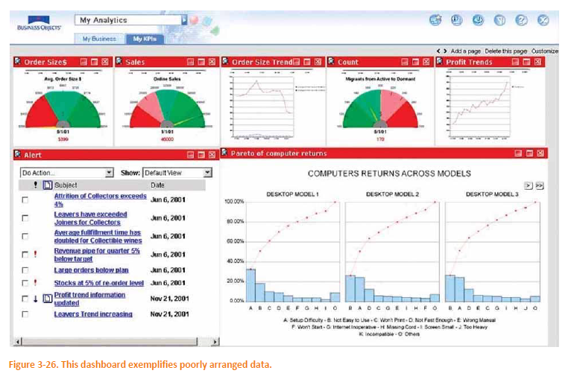
Data issues
Poor data arrangement
- This dashboard exemplifies poorly managed data

Slide 72

Data issues
Ineffective data highlighting

Slide 73

Design issues
Cluttering the display with useless decoration

Slide 74

Design issues
Cluttering the display with useless decoration

Slide 75

Design issues
Unattractive visual display

Slide 76
Recap
Information Dashboard
Definition
Three 3’s
Three Applications
Three Layers
Three types
Characteristics

Slide 77
Recap
Common Dashboard Design Mistakes
Design issues
Exceeding the boundaries of single screen
Meaningless Variety
Cluttering the display with useless decoration
Unattractive visual display
Display issues
Inappropriate display media
Poorly designed display media
Misuse or overuse of colors
Data issues
Inadequate context for the data
Using excessive detail or precision
Using deficient measure
Incorrect data encoding
Poor data arrangement
Ineffective data highlighting

Slide 78
References
Information Dashboard Design - Stephen Few
Chapter 1 : Clarifying the vision
Chapter 2: Variations in Dashboard Uses and Data
Chapter 3 : Thirteen Common Mistakes in Dashboard Design

Slide 79
Thank You!

